Slide 1
A grant funder cost perspective on best management practices
Sadie Drescher, Senior Program Officer
Jana Davis, PhD., Executive Director
Dan Hill, Intern & University of Maryland
Chesapeake Bay Trust
Notes:
Dan Hill, College of Behavioral and Social Sciences, University of Maryland College Park

Slide 2
Chesapeake Bay Trust

Slide 3
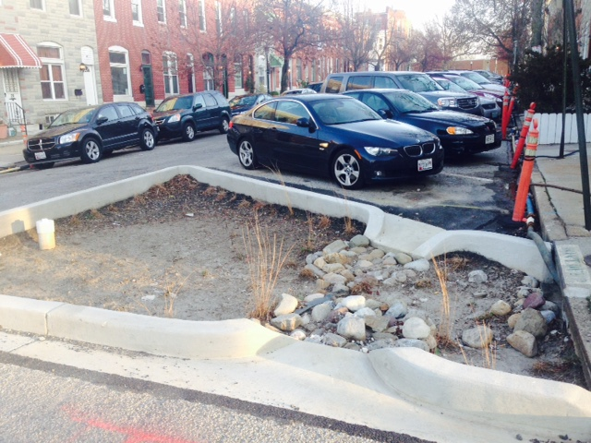
Questions
Does project location drive cost?
Does process drive cost?
How is project date related to cost?
Are big practices less expensive?
Are design costs 10% of the build cost?

Slide 4
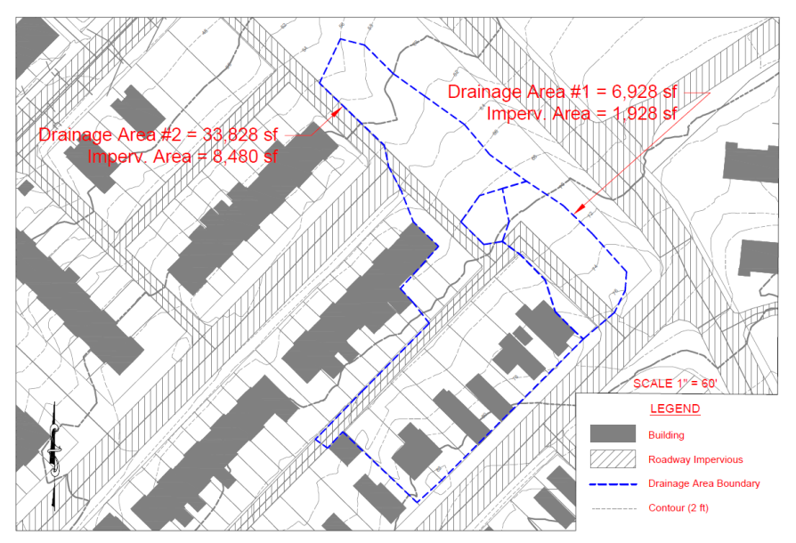
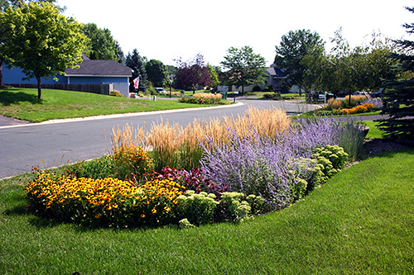
Methods
Rain garden and bioretention focus (n=50)
Factors we looked at were:
Project process
Design and construction & design/build
Date of build
Project size
Location
Notes:
Made some assumptions, such as permit as part of design (1/2 unless >$10,000 line item, then 1/3 of the line item was for permit) – assumption
Took out the cost of other items, e.g., permeable pavement
Used the total cost of the project costs associated with the BMP, so includes match reported for these cost items
Recorded data in detail to include CBT funded or total cost, contractor or applicant cost, and many other buckets of cost items, such as permits, signs, monitoring, planning, maintenance, indirect, project management – but there were not that many trends in this information.
Split out the individual practices, recorded CDA, IC of the CDA when possible, etc. However, lumped many of these BMP and cost parameters for the purpose of this talk.
Some files were outliers so did not use them and many practices didn’t report the CDA and/or IC of the CDA, so SA of the practice is the best dependent variable.

Slide 5
Notes:
Total project cost vs CBT cost of the project related to the rain garden or bioretention project

Slide 6
Question 1: Does project location drive cost?
n=18
n=12
n=2
n=5
Notes:
Western Shore (n): design build = 12; design = 5; build = 18
Western shore total = 35
Eastern Shore (n): design build = 2; design = 3; build = 2
Eastern shore total = 7

Slide 7
Question 1: Does project location drive cost?
n=11
n=5
Notes:
Western Shore (n): design build = 5; design = 2; build = 11
Western shore total = 18
Eastern Shore (n): design build = 2; design = 1; build = 1
Eastern shore total = 4

Slide 8
Question 1: Does project location drive cost?
n=1
n=5
n=1
n=2
Notes:
Western Shore (n): design build = 5; design = 2; build = 11
Western shore total = 18
Eastern Shore (n): design build = 2; design = 1; build = 1
Eastern shore total = 4

Slide 9
Question 2: Does process drive cost?
n=14
Notes:
design build = 14; design = 8; build = 18
Total = 42
$8/ft2 to $134/ft2 = range

Slide 10
Question 2: Does process drive cost?
n=12
n=7
Notes:
design build =7; design = 3; build 12
Total =22

Slide 11
Question 2: Does process drive cost?
n=12
n=7
Notes:
design build =7; design = 3; build 12
Total =22

Slide 12
Question 2: Does process drive cost?
 | Average TN $/lb | Average TP $/lb | Average TSS $/lb | n
Design | $ 3,085 | $ 31,084 | $ 61 | 3
Build | $ 10,502 | $ 96,948 | $ 185 | 12
Design/Build | $ 4,362 | $ 37,681 | $ 70 | 7
Notes:
MD DNR AND MDE are using the same numbers now, which come from the Phase 5.3.2 CB Watershed model. See page 42 of this document: http://www.mde.state.md.us/programs/Water/StormwaterManagementProgram/Documents/NPDES%20MS4%20Guidance%20August%2018%202014.pdf
Accounting for SW Wasteload Allocations and Impervious Acres Treated guidance fro NPDES, Aug 2014, p. 42 includes the annual urban loads per acre from the CBP version 5.3.2 for urban imp, urban pervious, and weighted all urban TN, TP, and TSS load reductions.

Slide 13
Question 3: How is project date of build related to cost?
n=5
n=15
n=5
n=6
n=9
Notes:
2008-2011 design/build n=5; design n=2, build n=5 and total n=12
2012-2015 design/build n=9; design n=6, build n=15 and total n=30

Slide 14
Question 4: Are big practices less expensive?
> 0.2 acres
> ~870 ft²
< 0.2 acres
< ~870 ft²
Notes:
Big practices are those that treat <0.2 acres or are less than ~870 ft sq

Slide 15
Question 4: Are big practices less expensive?
n=11
n=2
n=1
n=1
n=2
Notes:
design and build small n=1; design & build large n=2; Design small n=1, design large n =2; build small n=1; build large n=11
Total = 22
Big was defined as the CDA sum divided by the # BMPs to get those BMPs that treated 0.2 acres and larger as big and those that treated 0.2 acres and smaller as small

Slide 16
Question 5: Are design costs 10% of the build cost?
n=20
n=14
n=8
Notes:
Design costs in design/build were 6% of the build cost (only the total cost of the project and only the design cost or the build cost for each project type (ie design, design/build, build)
design & build n= 14; Design n=8, build n=20
Total = 42

Slide 17
Amount | Type | Source
$3 to $4 per ft² for residential | Measured/Guideline | LID Center
$10 to $40 per ft² for commercial | Measured/Modeled | LID Center
$5 to $45 per ft² | Guideline | UCONN Cost Calculator
$26 per ft² | Measured, Baltimore City (n=8) | Parks and People Foundation
$11.87 per ft² | Measured, Montgomery County (n=68) | RainScapes Rewards Rebates
22.54 per ft² | Measured, Montgomery County (n=20) | RainScapes Neighborhoods
$30 per ft² | Design/Build (n=14) | CBT
$14 per ft² | Design (n=8) | CBT
$50 per ft² | Build (n=20) | CBT
Notes:
PPF, Christina Bradley, n=8, 20012-2013
MoCo – Ann English
RainScapes Rewards Rebates – 68 Rain Gardens
Single Family: $11.87/ SF of RG to install; the county rebated, on average, $3.81/SF of RG
Commercial/Institutional: $18.17/ SF of RG to install; the county rebated, on average, $9.38/SF of RG
Impervious area (IA) treated in square feet (SF):
Average IA treated with projects on Single Family= 1284 SF
Average IA treated with projects on Commercial/Institutional: 8588 SF
RainScapes Neighborhoods – 20 Rain Gardens
If we have paid with county contractors, our average/SF of Rain Garden (designed to capture about 2.1” of rain – some were combinations of conservation landscapes and rain gardens but I included them since we estimated the treatment volume) is $22.54/SF of RG
Note, in addition to the installation cost for county projects, we also have a flat site assessment and design fee for projects which is not reflected in the $22.54/SF price.

Slide 18
Amount | Type | Source
$10,869 per IC | Measured/Modeled | King and Hagan (2011)
$4,907 per acre | Measured/Modeled | CWP’s Clean Water Optimization Tool (2015)
$60,000 per IC acre | Guideline | CBT Green Streets, Green Jobs, Green Towns grants (2015)
< $100,000 per IC acre | Guideline | MD County
< $200,000 per IC acre | Guideline | Another MD County
$45,149 per IC acre | Design/Build (n=7) | CBT
$46,000 per IC acre | Design (n=3) | CBT
$96,630 per IC acre | Build (n=12) | CBT
Notes:
MD DNR AND MDE are using the same numbers now, which come from the Phase 5.3.2 CB Watershed model. See page 42 of this document: http://www.mde.state.md.us/programs/Water/StormwaterManagementProgram/Documents/NPDES%20MS4%20Guidance%20August%2018%202014.pdf
Accounting for SW Wasteload Allocations and Impervious Acres Treated guidance fro NPDES, Aug 2014, p. 42 includes the annual urban loads per acre from the CBP version 5.3.2 for urban imp, urban pervious, and weighted all urban TN, TP, and TSS load reductions.

Slide 19
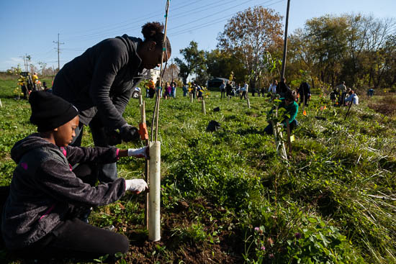
Other questions? Are rain gardens and bioretentions a cost effective BMP? Who is doing and paying for maintenance and monitoring? What do you find? What is next?
Notes:
We have 26,000 volunteers and 166,000 volunteer hrs in 2014 – how does this factor into this cost analysis?
For the 50 studies here, 1839 volunteers were reported.
What are the other benefits of rain gardens and bt’s other than cost? Quality of life, education, etc.

Slide 20
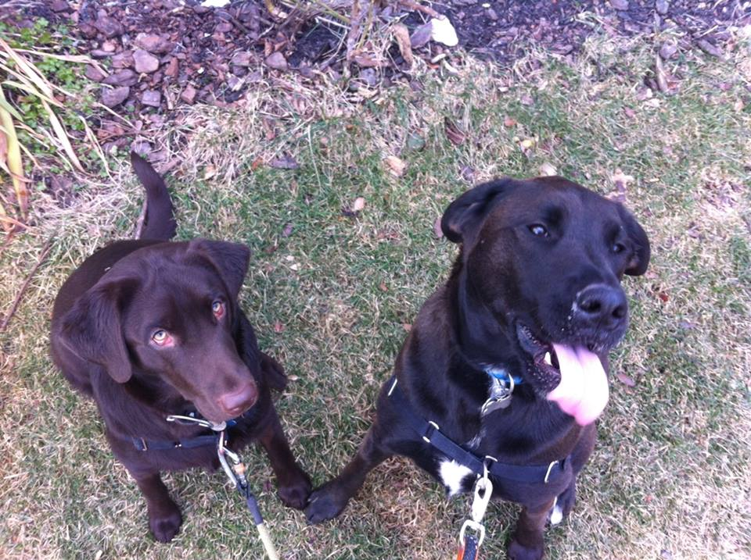
Let me know what you think
You paid how much for that rain garden ?!!??
Sadie Drescher
Senior Program Officer
Chesapeake Bay Trust
60 West Street, Suite 405
Annapolis, MD
Phone: 410-974-2941 xt 103
Email: sdrescher@cbtrust.org

