Slide 1
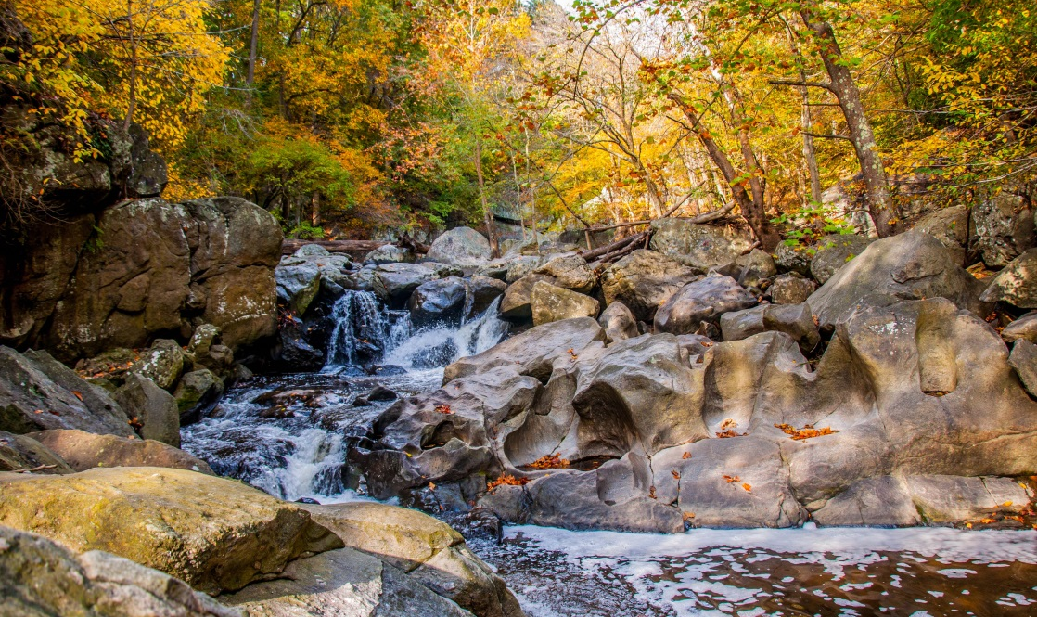
Navigating a Phase II Permit: Montgomery Parks Perspective
Jai Cole
Natural Resource Manager
Jai.Cole@montgomeryparks.org
Amanda Matheny
Senior Natural Resource Specialist
Amanda.Matheny@montgomeryparks.org

Slide 2
M-NCPPC Montgomery County Department of Parks
Commission formed in 1927
The preparation, adoption and from time to time, amendment or extension of the General Plan (On Wedges and Corridors) for the Physical Development of the Maryland-Washington Regional District within Montgomery and Prince George’s Counties.
Montgomery County
(District of Columbia)
Prince George’s County
Acquire, develop, operate and maintain a public park system.

Slide 3
Phase II State and Federal MS4 Permit
Develop and implement
Best Management Practices (BMPs)
for the 6 Minimum Control Measures
Personnel Education and Outreach
Pollution Prevention and Good Housekeeping
Illicit Discharge Detection and Elimination
Construction Site Runoff Control
Post Construction Stormwater Management
Public Involvement and Participation
Received Permit in 2010

Slide 4
National Pollutant Discharge Elimination System
Entity | Type | Permit Type
Montgomery County | Phase I – Large Jurisdiction MS4 | Individual
City of Rockville, Gaithersburg etc. | Phase II – Small Municipality MS4 | General
Montgomery Parks (M-NCPPC) | Phase II - State and Federal Small MS4 Agencies Industrial Site Permits (Maintenance Yards) | General
Other Phase II - State and Federal Small MS4 Agencies:
Ft. Detrick

Slide 5
National Pollutant Discharge Elimination System
Entity | Type | Permit Type
Montgomery County | Phase I – Large Jurisdiction MS4 | Individual
City of Rockville, Gaithersburg etc. | Phase II – Small Municipality MS4 | General
Montgomery Parks (M-NCPPC) | Phase II - State and Federal Small MS4 Agencies Industrial Site Permits (Maintenance Yards) | General
Other Phase II - State and Federal Small MS4 Agencies:
Ft. Detrick

Slide 6
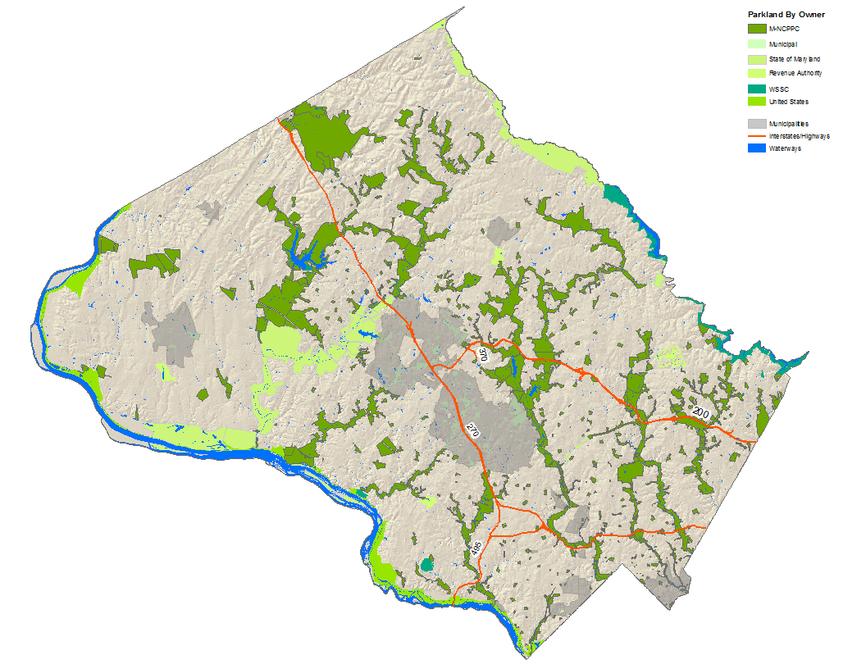
M-NCPPC Parks, Montgomery County
420 Parks
Over 36,000 acres
Approximately 8,947 Developed Acres
Over 26,354 Unprogrammed Acres

Slide 7
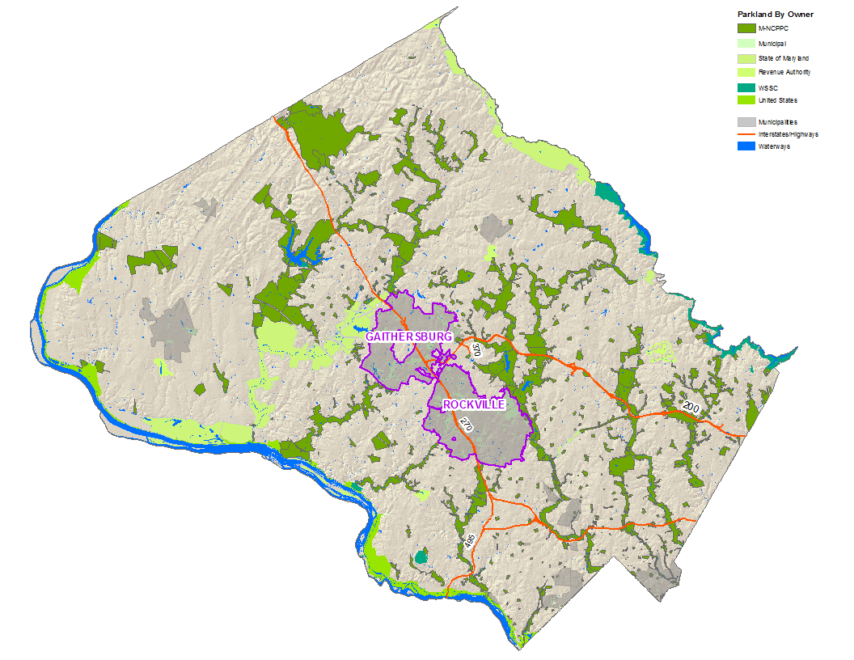
M-NCPPC Parks, Montgomery County
420 Parks
Over 36,000 acres
Approximately 8,947 Developed Acres
Over 26,354 Unprogrammed Acres

Slide 8
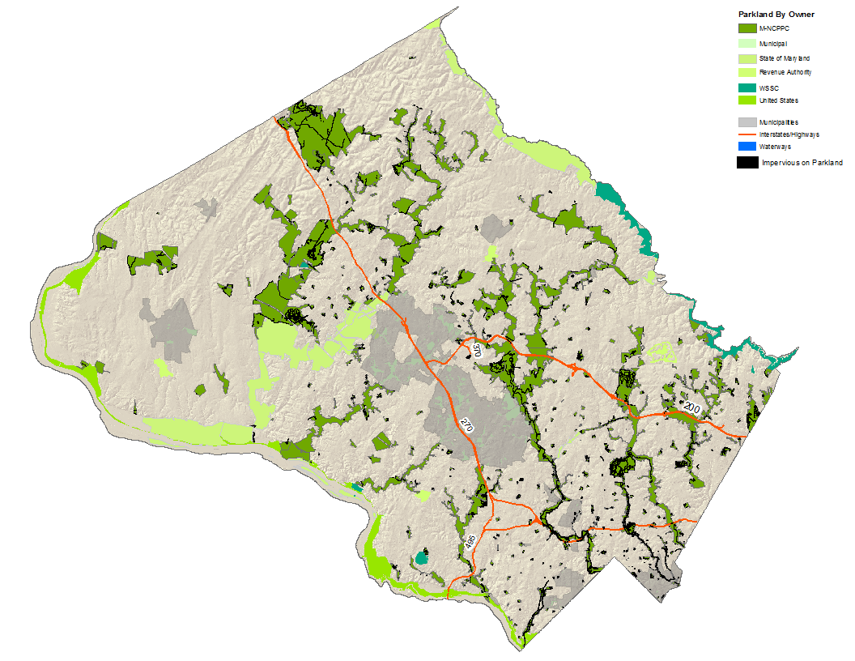
Impervious surface in parkland (acreage)
M-NCPPC Parks, Impervious Surface
Total Impervious Acreage on M-NCPPC Parkland: 738 acres

Slide 9
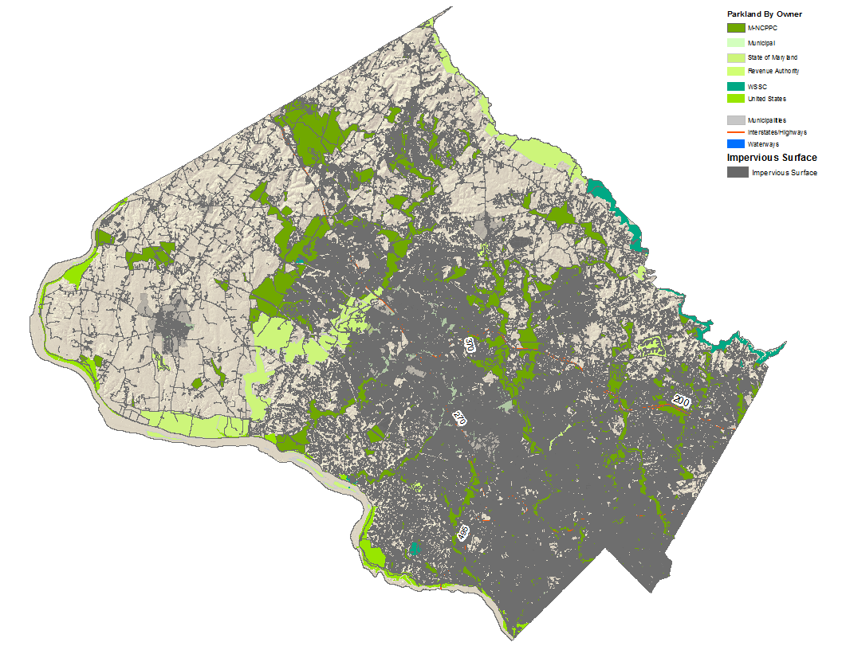
Impervious surface in parkland (acreage)
M-NCPPC Parks, Impervious Surface

Slide 10
M-NCPPC Parks, Montgomery County
420 Parks
Over 36,000 acres
Approximately 8,947 Developed Acres
Over 26,354 Unprogrammed Acres

Slide 11
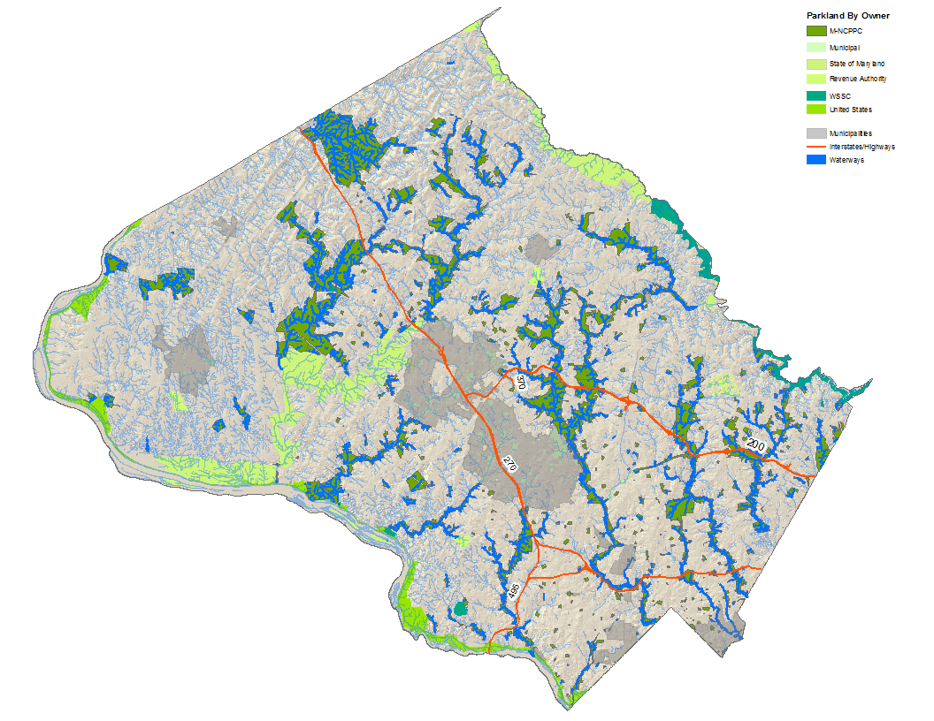
M-NCPPC Parks, Montgomery County
420 Parks
Over 36,000 acres
Approximately 8,947 Developed Acres
Over 26,354 Unprogrammed Acres

Slide 12
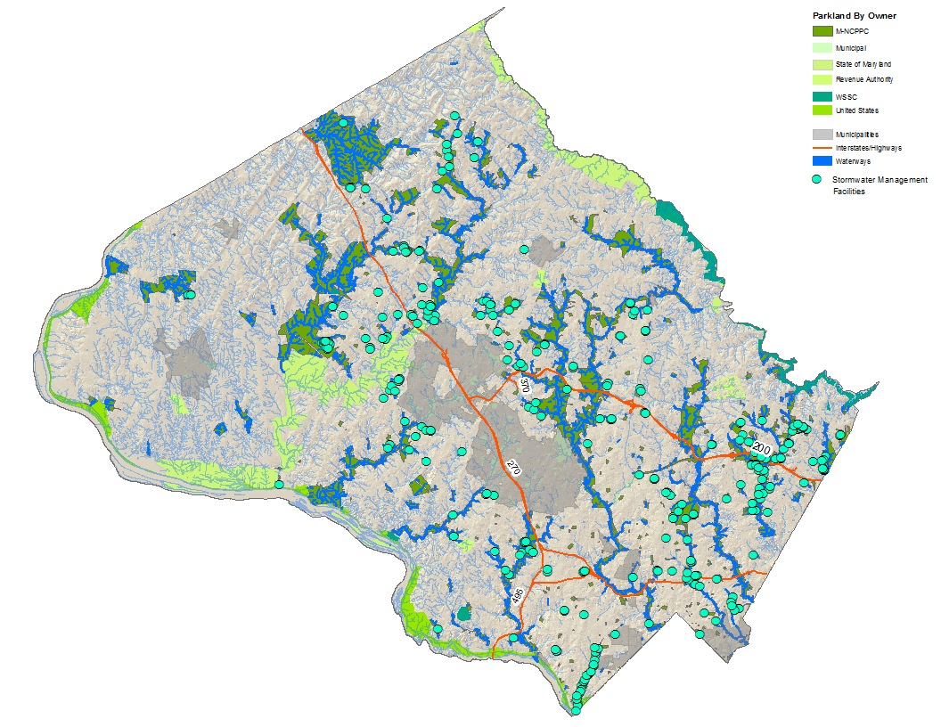
Parks Stormwater Management Facilities
More than 525 stormwater management facilities on parkland… and growing!

Slide 14
First thing we did – Establish Core Team
NPDES

Slide 15
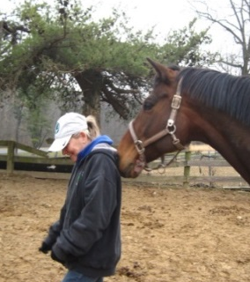
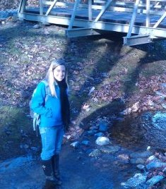
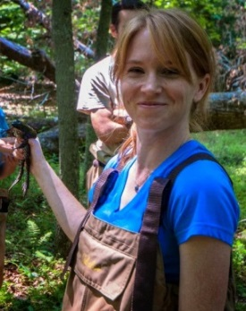
Erin McArdle
Environmental Engineer
?
Henry Coppola
Stream & Park Cleanup Coordinator
Nancy Blum
Water Quality Manager
Vacant
Water Quality Manager
Jody Fetzer
Green Management Coordinator
Left to right
Amanda Matheny
Senior Natural Resources Specialist
Geoffrey Mason
Principal Natural Resources Specialist
Kate George
Natural Resources Specialist

Slide 16
How do We Communicate Up the Chain?
?
?
?

Slide 17
NPDES – Communication Structure
Quarterly
Monthly Focus
Directorate, Division Chiefs, Core Team and their Supervisors
Core Team and their Supervisors
Core Team
Staff from most Parks Divisions tasked with NPDES Initiatives
# of staff involved

Slide 18
Spreading the Word on NPDES
Photo Credit: Diligences.com

Slide 19
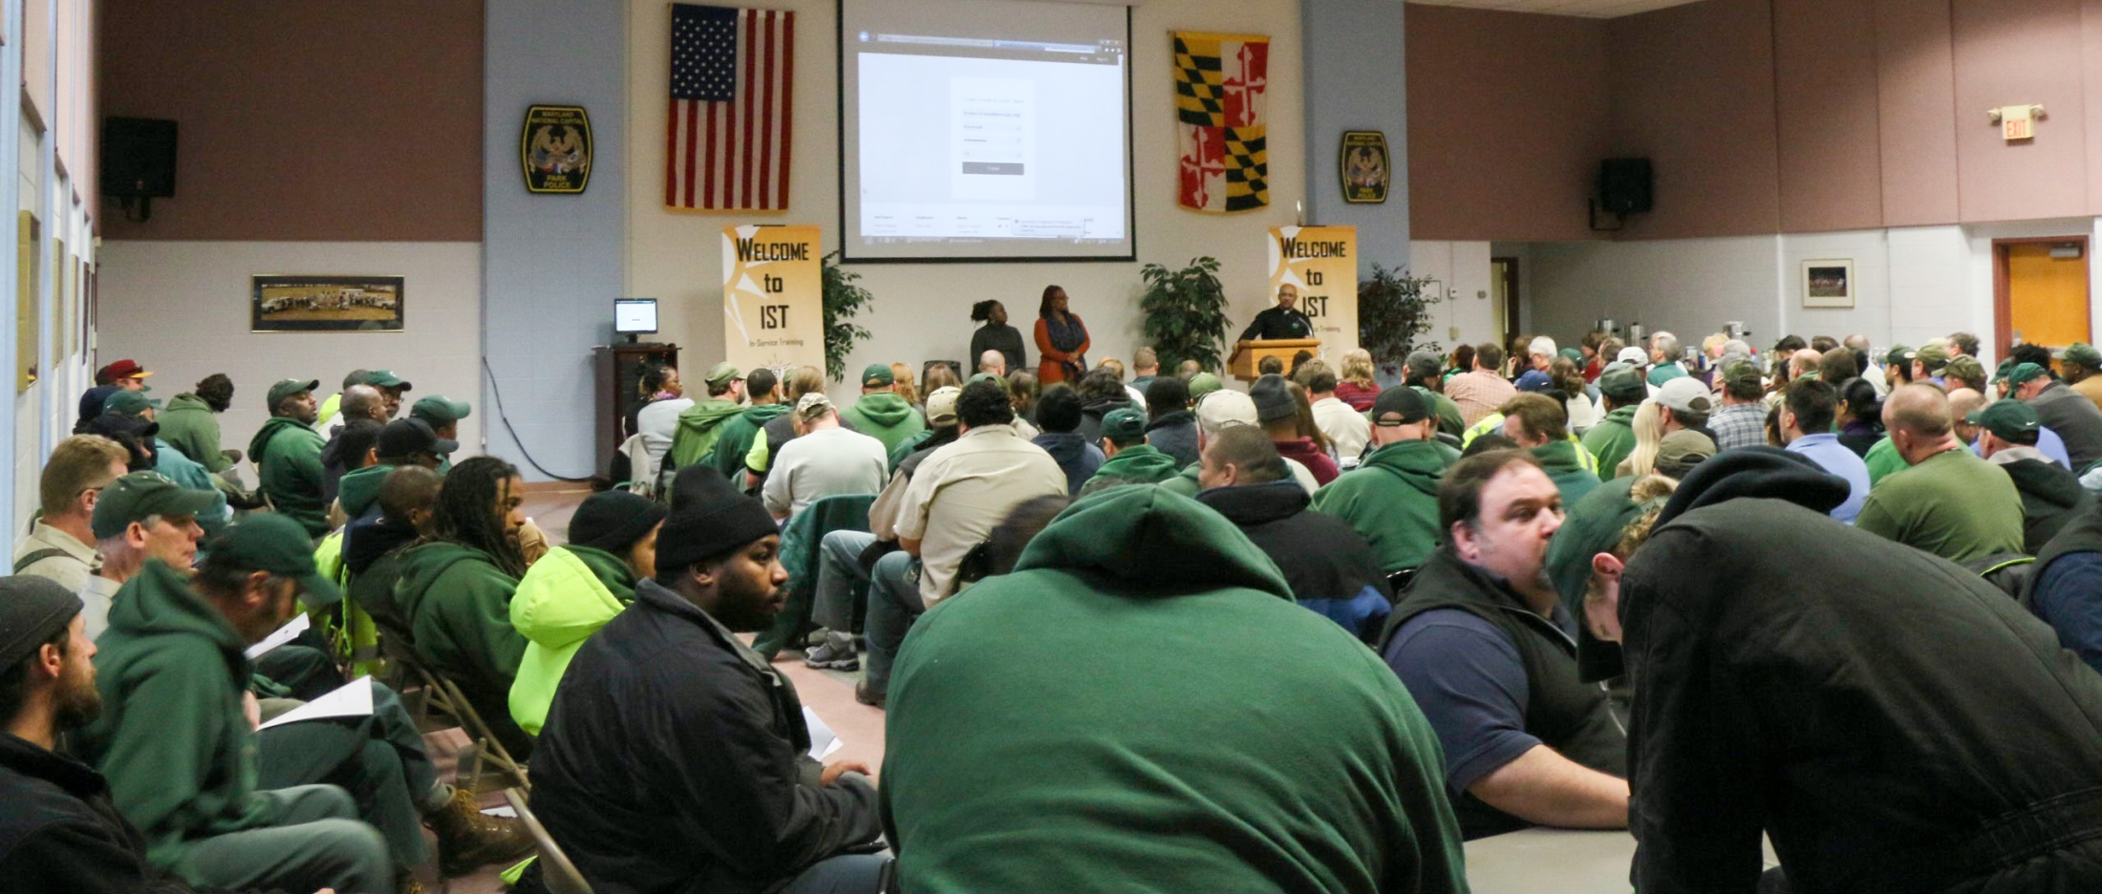
Spreading the Word on NPDES

Slide 20
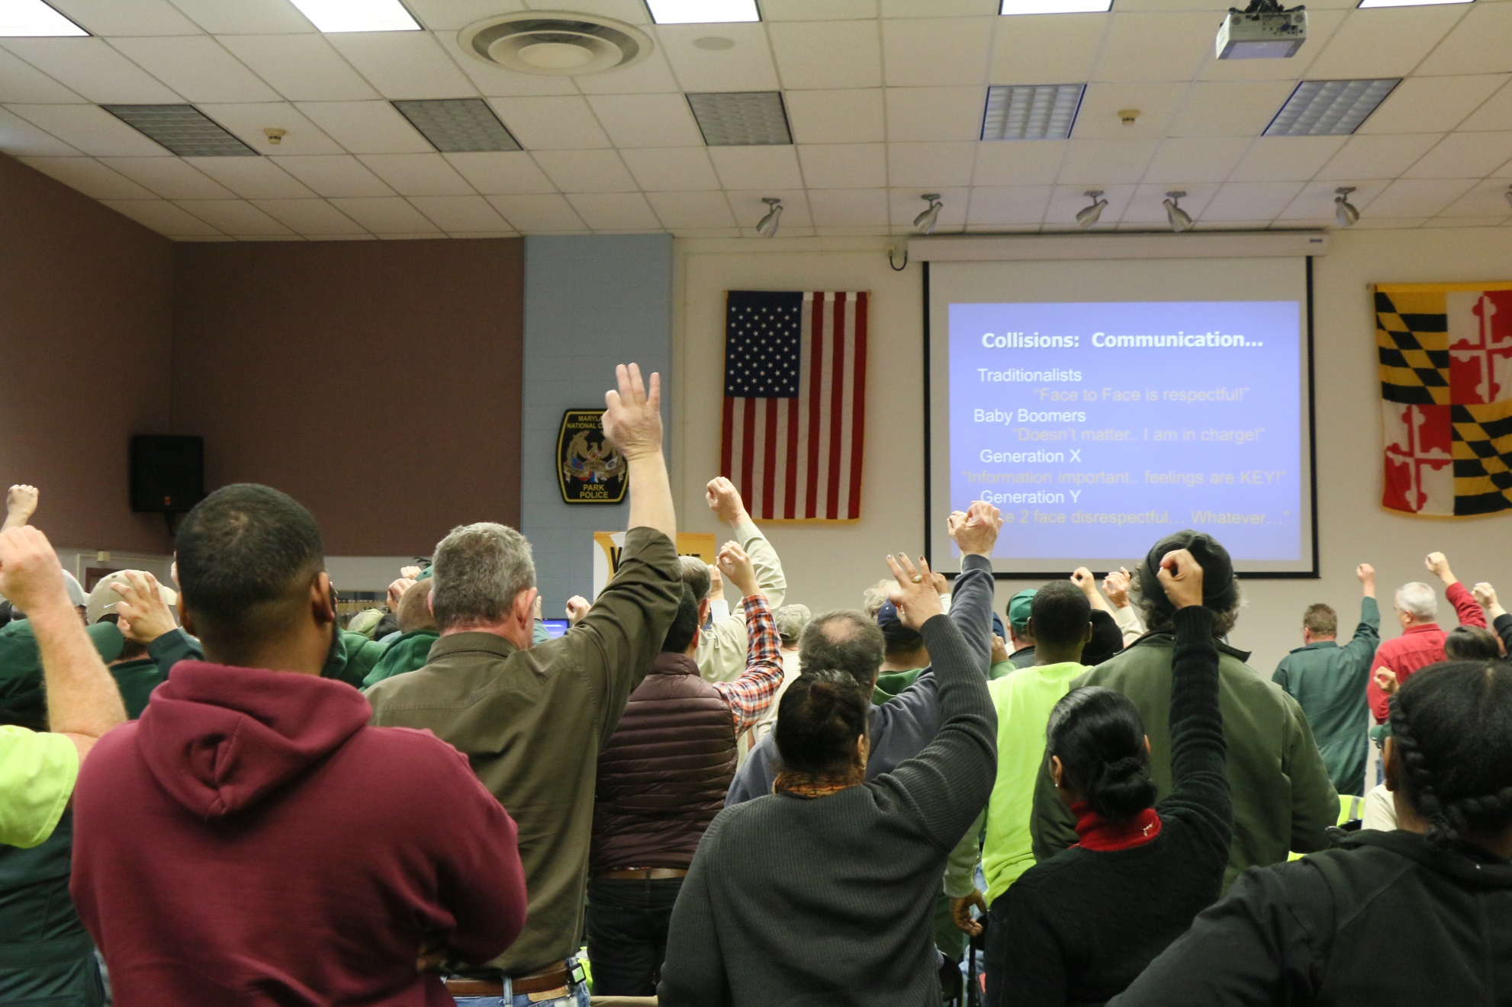
Reaching a Tipping Point

Slide 21
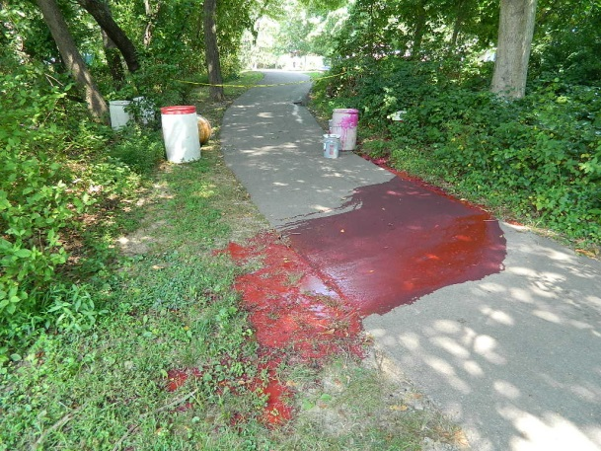
Core Team Responsiveness

Slide 22
…sometimes it’s what NPDES can do for you…
It’s not always what you can do for NPDES…

Slide 23
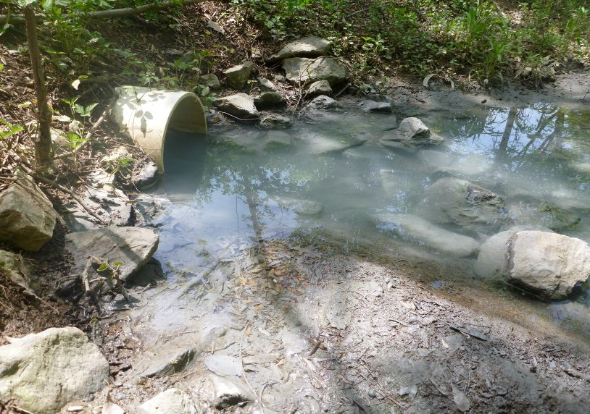
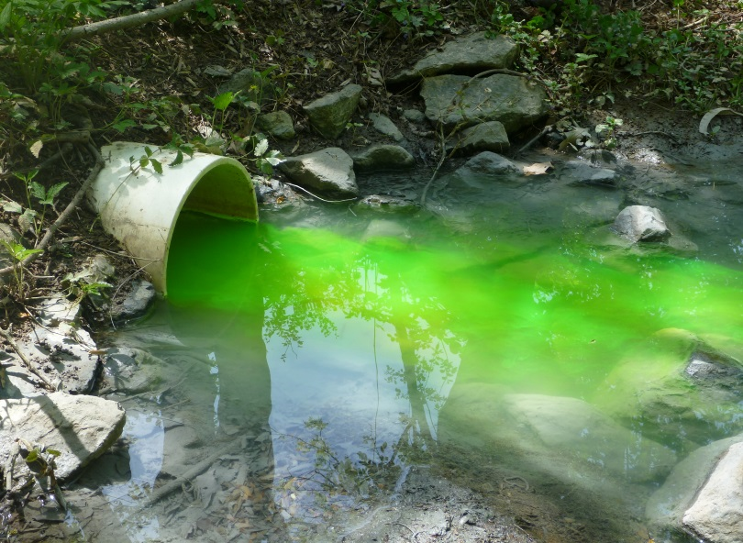
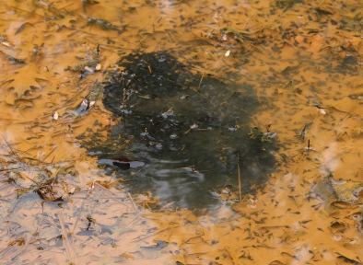
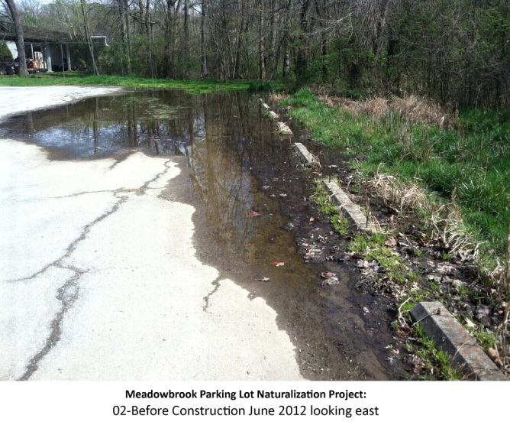
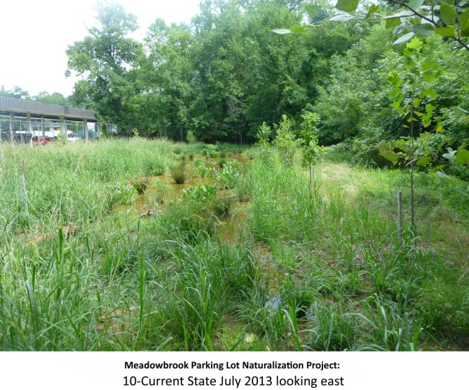
Core Team Responsiveness
NPDES becomes a “way of life” at Parks
Staff recognized consistent discharge to sand filter.
Dye testing conducted to identify source of pollution.

Slide 24
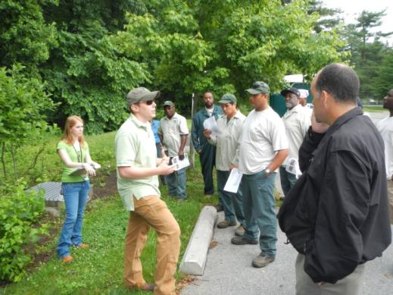
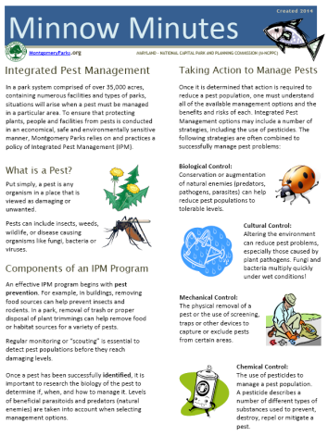
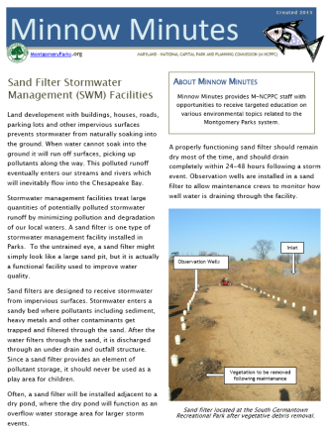
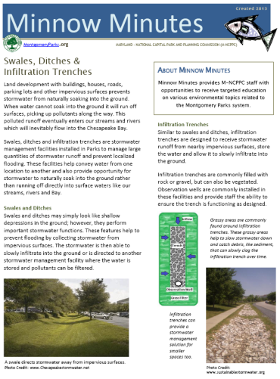
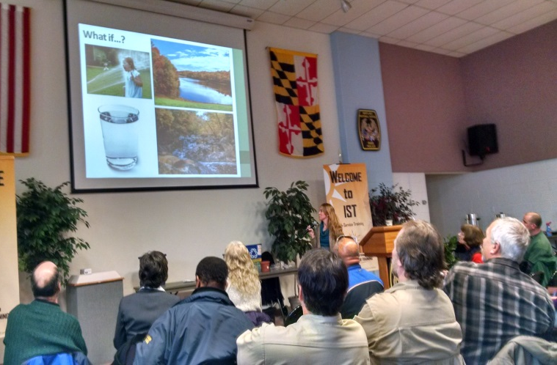
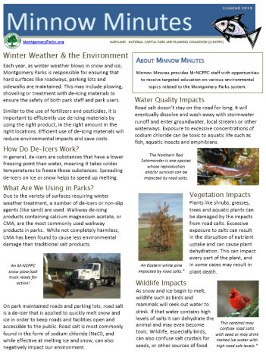
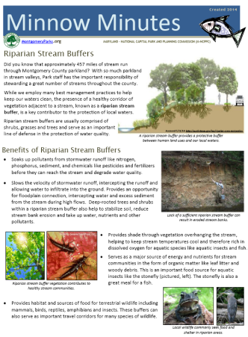
Personnel Education & Outreach
Hands-on workshops
Small group presentations
Targeted written materials
Provide staff a connection between work program responsibilities/tasks and stewardship of natural resources.

Slide 25
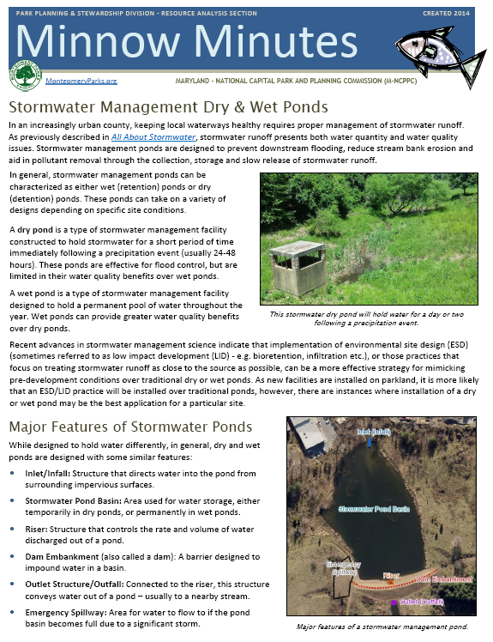
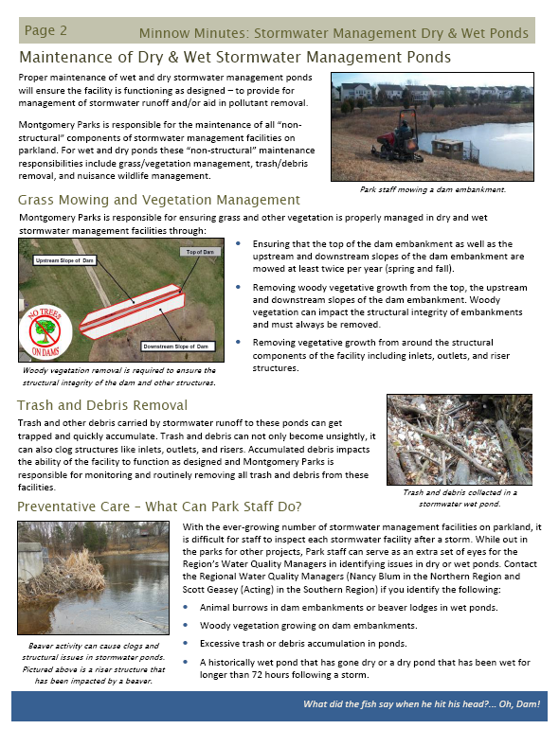
From Minnow Minutes to… Environmental Toolbox Talks
SWM Facilities
Tree Care
Stream Closures
Nutrient Mgmt.
BMPs
Spill Response
Minnow Minutes received an MRPA Creative Programming Award in 2014

Slide 26
Parks Stormwater Management Facilities
More than 525 stormwater management facilities on parkland… and growing!

Slide 27
Parks Stormwater Management Facilities
CHALLENGE
More than 525 stormwater management facilities on parkland… and growing!

Slide 28
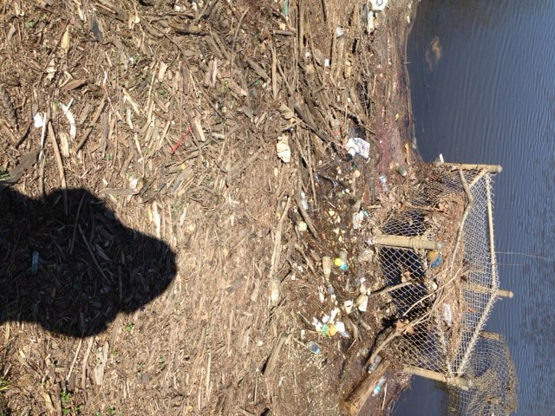
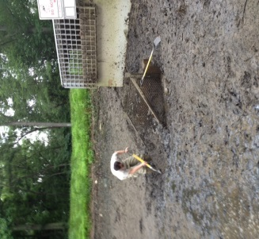
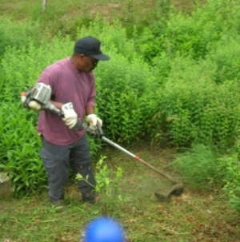
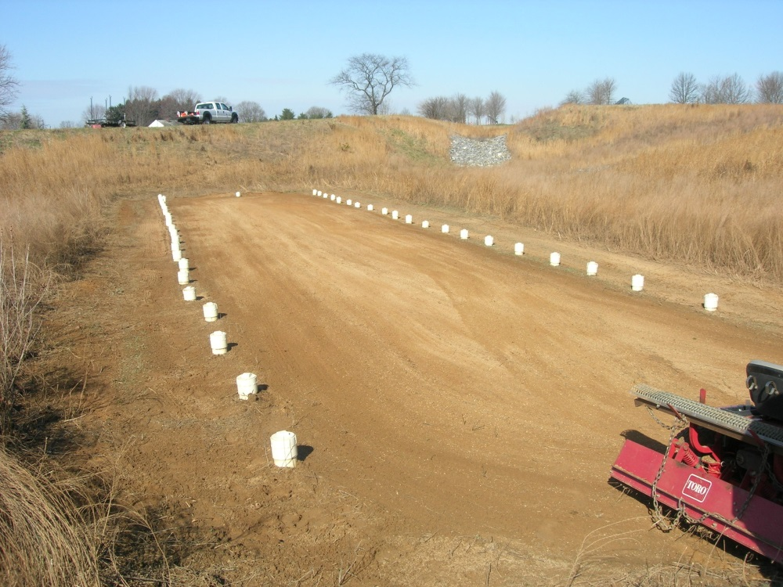
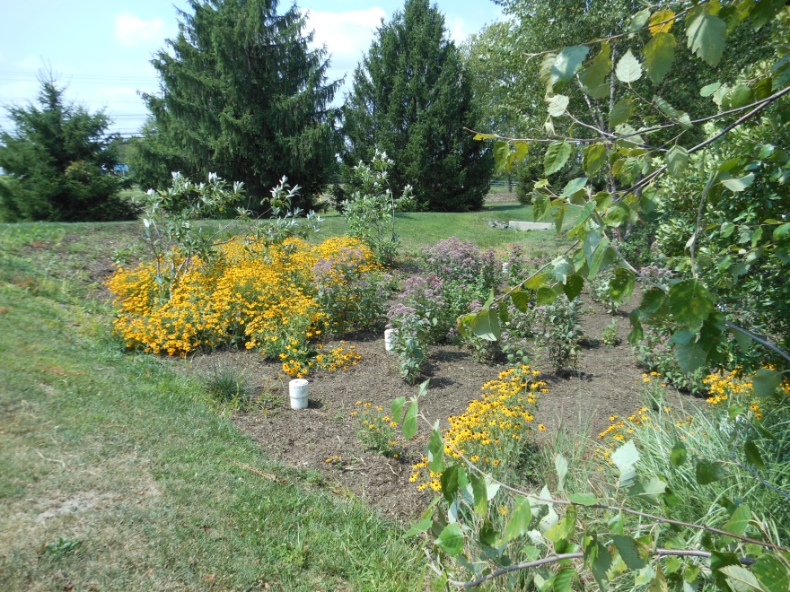
Stormwater Management Facility Maintenance
Parks is responsible for non-structural “aesthetic” (day to day) maintenance.
Montgomery County DEP responsible for structural maintenance.

Slide 29
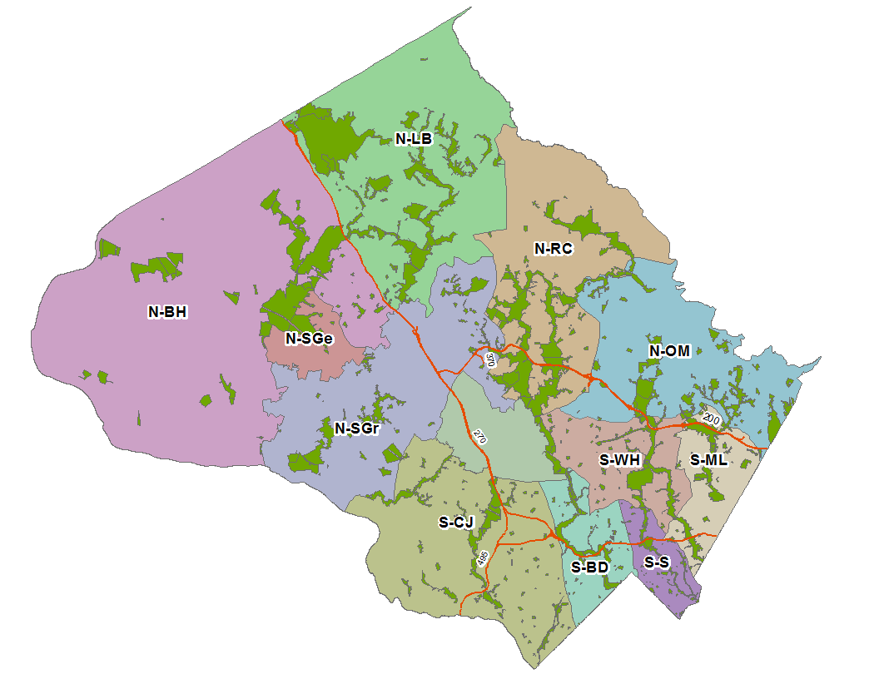
Maintenance Areas
Park Management area map
Neglected pond
Wrong stuff

Slide 30
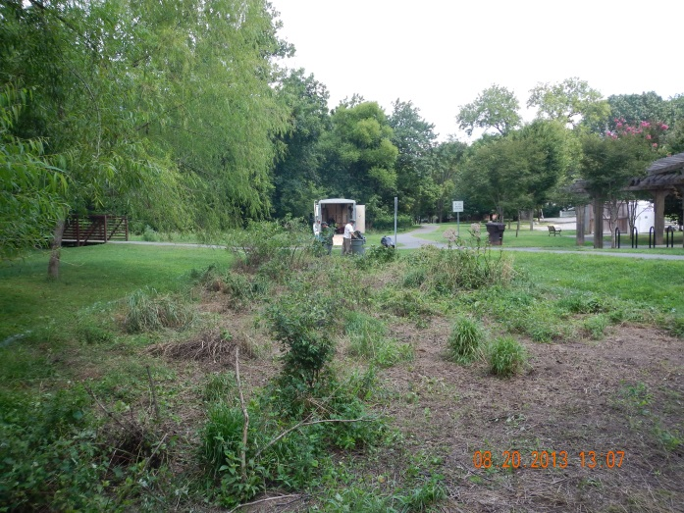
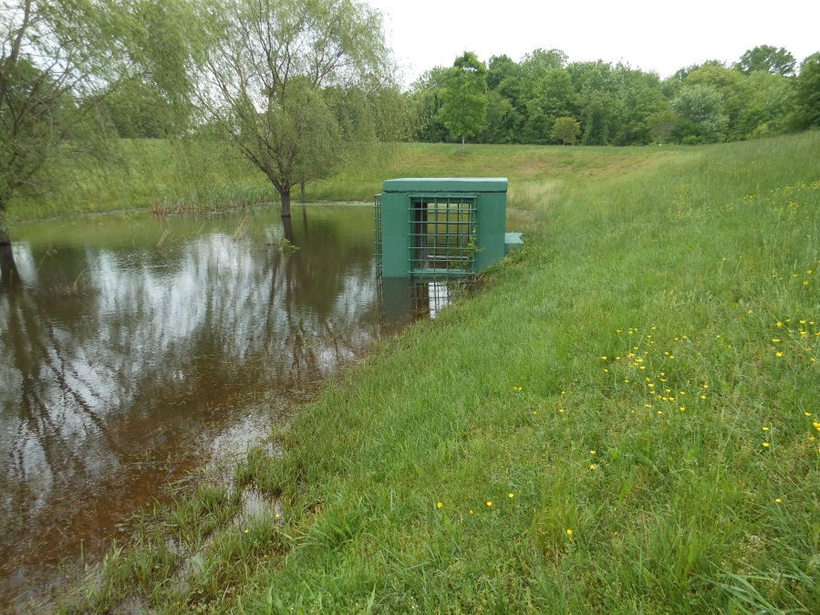
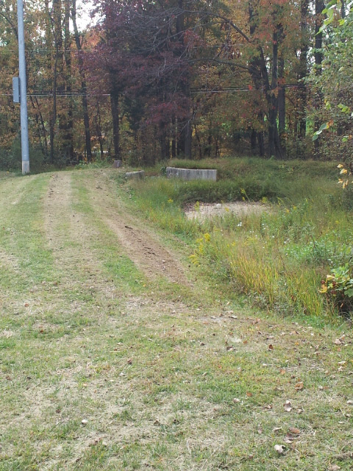
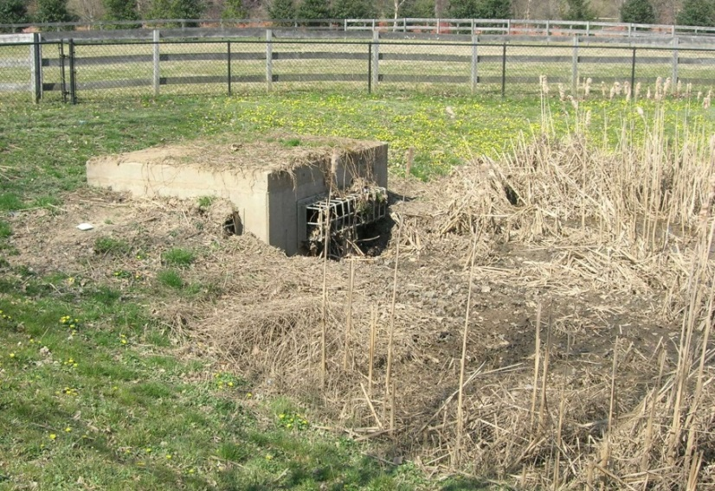
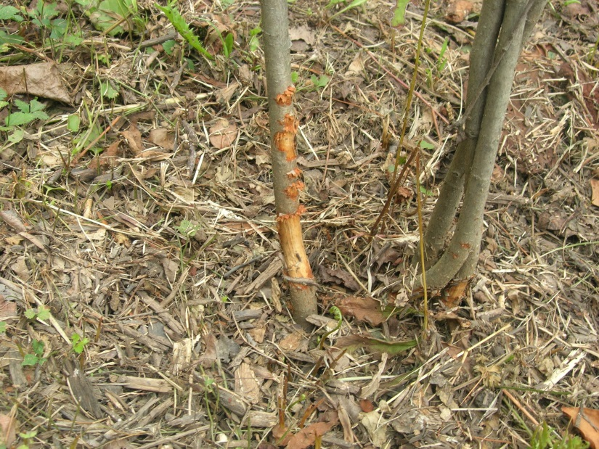
Stormwater Facility Maintenance
Plants Not Maintained Well in Bioretention
Park Management area map
Neglected pond
Wrong stuff
Dry Pond in disrepair
Clogged Riser
Embankment Scalping with Mower
String Trimmer Damage

Slide 31
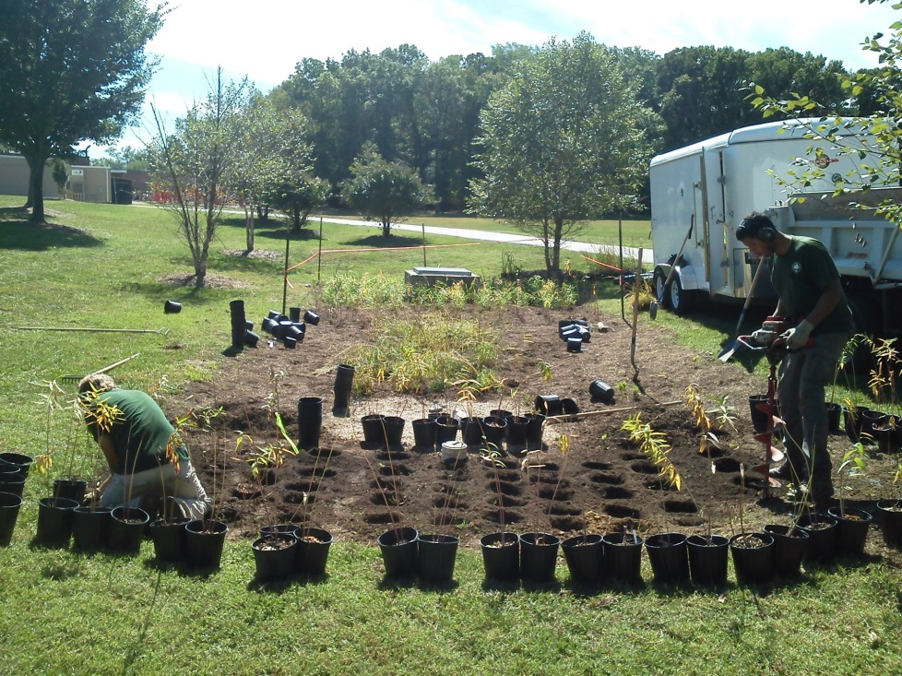
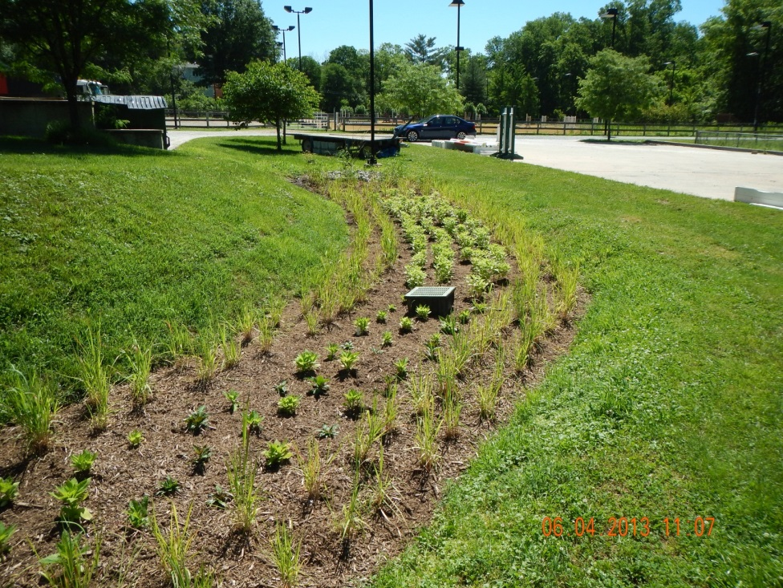
Centralization of Responsibilities
Water Quality Manager in each region, responsible for overseeing maintenance of SWM facilities on parkland.

Slide 32
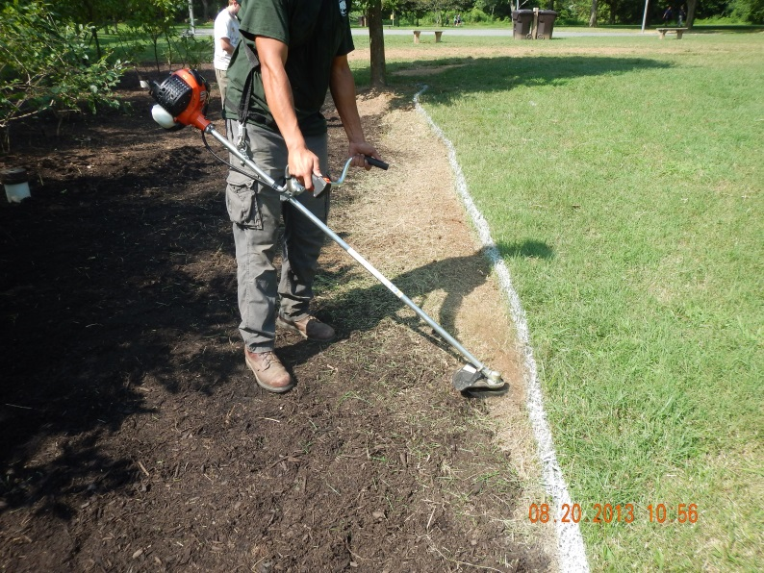
Centralization of Responsibilities

Slide 33
Centralization of Responsibilities

Slide 34
Centralization of Responsibilities
Support proper maintenance through simplistic planting (3-4 plant species) and strategic planting design (geometric patterns)

Slide 35
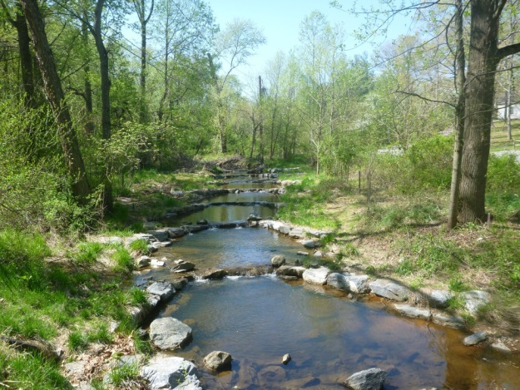
Projects on Parkland
Stream Restoration & Wetland Creation
Stormwater Management Facilities
New Facilities
Retrofit Existing Facilities
Transportation Projects/Mitigation
Examples: ICC MD-200, Purple Line, Brookeville Bypass, DOT sidewalk (Franklin Ave.) etc.
Other infrastructure-related projects
Examples: WSSC, Washington Gas, SHA etc.

Slide 36
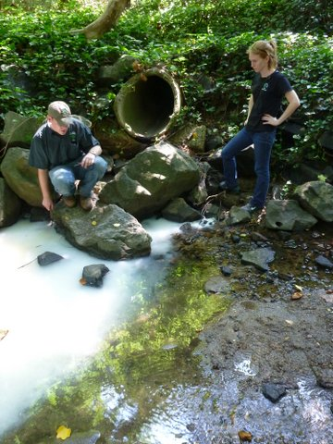
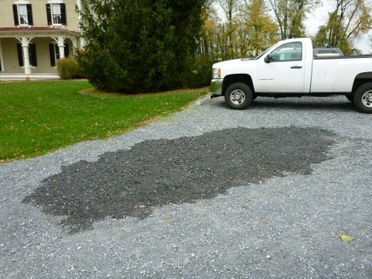
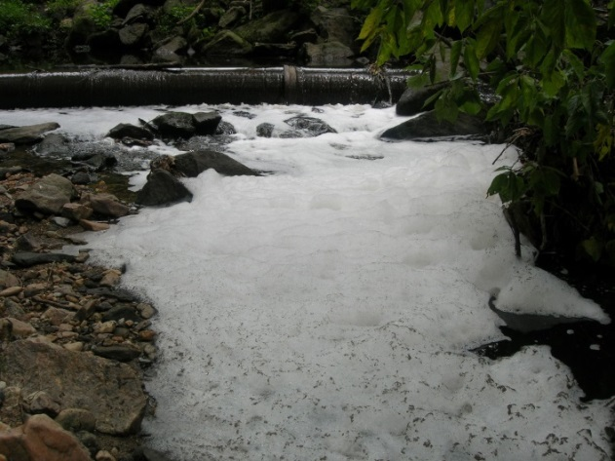
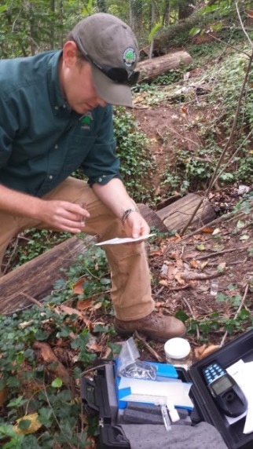
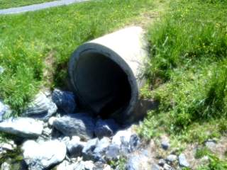
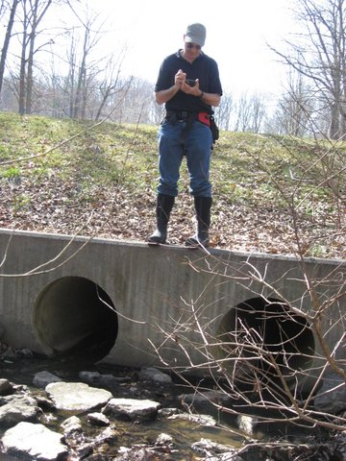
Collaboration with External Agencies
Response to Environmental Issues
Illicit Discharge Detection & Elimination Monitoring

Slide 37
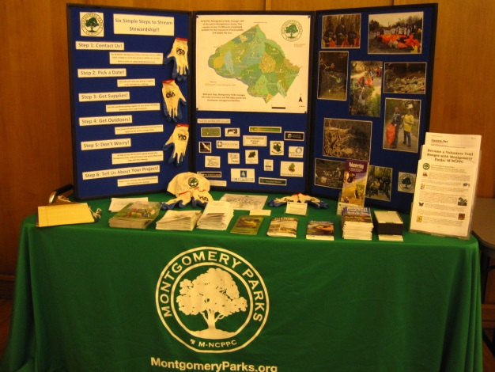
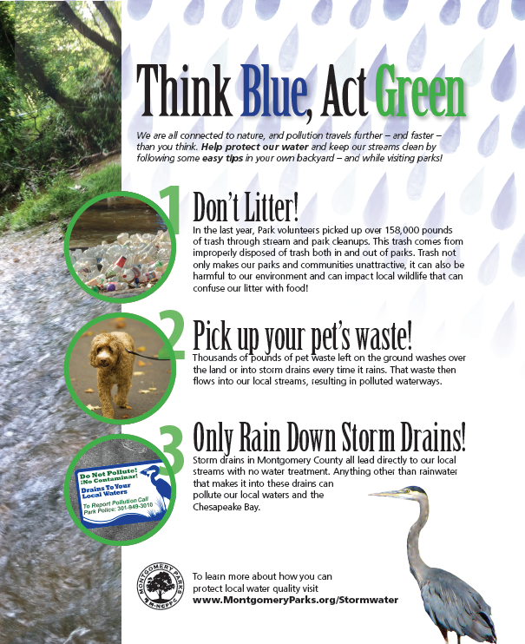
Collaboration with External Agencies
Opportunities to Engage
Communities

Slide 38
Engaging with Stakeholders and Volunteers
Stormwater Partners
Eyes of Paint Branch
Friends of Cabin John Creek
*Images depict a representation of groups and is not a complete list.
Volunteer
Cleanups

Slide 39
Industrial Permit
12 NPDES Permits for Industrial Sites
Whenever possible, conduct training in small groups
Second-round Maintenance Yard inspections are now conducted with Supervisor present

Slide 40
Industrial Permit
Stormwater Pollution Prevention Plans

Slide 41
Industrial Permit
Stormwater Pollution Prevention Plans

Slide 42
Questions?

