Slide 1
RETROFITTING EXISTING SWM PONDS
BETTER THE SECOND TIME AROUND
Lise Soukup, P.E.
Environmental Engineer
City of Rockville, Maryland
April 16, 2015
www.rockvillemd.gov

Slide 2
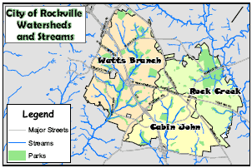
City of Rockville, Maryland
Located north of Washington DC in central Montgomery County
60,000 residents, City size 13 sq. miles
NPDES Phase II Community
City owns & maintains 205 public SWM facilities, including:
33 wet ponds
28 dry ponds

Slide 3
Maximizing Your Public SWM Program
Goal - effective, affordable and extensive water quality treatment for your community
SWM options for existing impervious areas to get MS4 credit:
Build new SWM
Replace older SWM facilities with more effective treatment
Upgrade existing SWM systems for better efficiency
Do preventative maintenance so what you have keeps working
Notes:
Rockville is anticipating our next MS4 permit re-issuance. Getting water quality coverage of 20% of our ‘untreated’ area takes strategic planning.
First, we look for low-hanging fruit. The cost-benefit of retrofitting existing SWM facilities is high compared to building a new facility. If the underground vault or surface pond basin already exists, you save a big part of the construction cost. And shoe-horning in larger SWM facilities to a built landscape is often impractical, given the many other existing features to work around. By the time you’ve compromised the facility’s design to fit a constrained footprint, it may be so undersized that it’s not worthwhile.
We’re also thinking about how to make retrofitted & new facilities as effective and easy to maintain as possible.
Preventative maintenance and upstream source control is essential, for ponds and really, any kind of SWM facility. They’re expensive to build, and expensive to keep functioning. We expect typical urban non-point source runoff loads, but recognize that heavy sediment loads from construction sites, water main breaks, or chronically dirty land uses is like putting 50,000 miles a year on your car. It might take it, but you’ll pay for it.

Slide 4
Retrofits Of Existing Ponds – Great Returns
Larger drainage areas that treat lots of impervious acres
Already located to easily intercept storm flows
Can be modified to provide or increase water quality treatment
Easier to obtain wetland and waterway construction permits for retrofit of online ponds
Pond is already part of the neighborhood – less of a fight than creating a new pond in the community’s open space
Can enhance it with aesthetic and environmental features
Notes:
I focused this talk on retrofitting SWM ponds because many communities have a lot of these. They were ubiquitous from the 1980s on in our early SWM programs. They’re relatively straight-forward to modify, although each one is a little different. I like ponds – they let us see how our SWM is working, or not working. They form another type of aquatic habitat, and help break up the urban landscape.
And they make a big difference. As MS4 communities, we’re all looking for combinations that get us the most credit under MDE’s 2014 MPDES MS4 Accounting for SWM Guidance Document. Although some retrofits may only get partial credit, such as a pond that only has space for half an inch of WQv, these partial credits really add up on the larger drainage areas. If you’re okay with converting the small-storm quantity storage to additional water quality storage, you may get the full credit.
Easier to obtain wetland and waterway construction permits to modify, since the basin and dam disturbance are already done

Slide 5
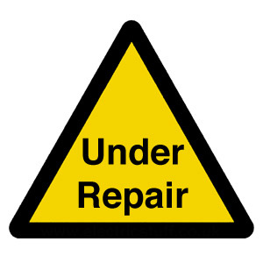
Which Ponds To Retrofit?
Inventory SWM facilities for good opportunities – facilities that you needed to work on anyway.
Dry ponds with good access and big drainage areas
Wet ponds that can have more of basin volume assigned to water quality storage
Ponds with high maintenance demands – add forebay separators, modify trash racks or risers
Ponds with safety issues or deteriorated structures
Ponds that need dredging to restore basin storage volume
Which ponds to stay away from?
Notes:
Inventory SWM facilities for good opportunities – facilities that you needed to work on anyway.
Under current MS4 permits, we’re required to keep SWM facilities functional, at least the ones we’re claiming for our SWM accounting credit. The days of building it and ignoring it for the next 20 years are gone. So if you have to put money and maintenance effort into an outdated or poorly performing facility anyway, make it work for your program.
Dry ponds with good access and big drainage areas
Easy retrofit candidates to become a wet pond in commercial/office areas. Less focus on child safety, aesthetics, and tree impacts. When in residential communities, plan to add some aesthetic elements to these if they’re near houses, and safety elements for gentler slopes, plantings around edges.
Wet ponds that can have more of basin volume assigned to water quality storage
Older wet ponds from the 1990s and 2000s have wet pools that meet water quality treatment goals and dry storage above the wet layer where the water level fluctuates during storms. Depending on the pond’s inflow pipes and outlet structures, you can increase the volume of this wet layer. Take away some water quantity storage and make more water quality storage. Or over-excavate the bottom of the pond to deepen the wet pool layer.
Ponds with high maintenance demands – add forebay separators, modify trash racks or risers
If you’re spending thousands of dollars each year to unblock a pond that frequently jams up, tweak the design features. Unlike roads or sewer lines, ponds are pretty unique. Each one has its own characteristics, variations on the outlet design or drainage area loads. You may have to play with it a bit to make it behave.
Ponds with safety issues or deteriorated structures
Even if you want to keep the dry pond from the 1980s, you’ll need to eventually replace that old corrugated metal pipe mushroom riser or line the CMP barrel through the dam. It’s okay to just replace the structures with the same size and design. Pay attention to whether installation methods have changed since the original notes went on your as-built plans, though. And decide if you’d rather have a lower-maintenance design.
If you’re installing a new riser anyway, look at adjusting the pond’s low-flow and overflow elevations to add wet storage. A quick engineering study on the pond’s runoff routing and hydraulics will show you how much increased water quality volume you might get.
Ponds that need dredging to restore basin storage volume
WHICH PONDS TO STAY AWAY FROM?
Ponds that are so undersized for drainage area, you can’t achieve even 0.5” of WQv. (Depends on how desperate you are to get partial credit…)
Ponds that are surrounded by obstacles making it difficult to do future routine or major maintenance. Can you afford to restore a fancy golf course every time you dredge it?
Older ponds located adjacent to stream channels in wetlands. We have some 1980s-era dry ponds with dams wedged up against stream channels. Is expanding these worth the fight for wetland/waterway permits? Or the adjacent residents’ objection to large-scale clearing in the stream valley?
Ponds with minimal drainage area/hydrology, especially those fed only by storm drains. If the current pond doesn’t receive enough water to keep a wet pool wet, it’ll be an eyesore, and perhaps a maintenance headache. Depending on groundwater sources and the upstream impervious area, ponds need drainage areas of at least 20-30 acres.

Slide 6
Rethinking Your SWM Facility
Improve Wet Pool Storage for Functionality
Shallow marsh areas fill up in 3-7 years
Deepen main wet pool areas
Retain shallow wetland fringe around shoreline
Replace/enhance worn or high-maintenance structures
Eliminate clogging potential
Slip-line CMP pipes
Plan for Future Maintenance & Retrofitting
How will you handle ESC and diversion next time?
Improve access into pond
Notes:
SWM facility design has evolved – a LOT – over my career. So we keep finding that the ‘next best thing’ we put into a pond in the 1990s or 2000s may not work as well as we thought it would. For instance, wetland marsh ponds were highly encouraged 15 years ago. Today, we find they have a short shelf-life before the marshes become ineffective upland areas, the diverse planting get conquered by monoculture cattails, and the plants only take up nutrients during 6 months anyway. So, it’s okay to modify designs with newer or more practical measures.
And each pond is a little different – different designers, different pre-fab products, different space or elevation constraints. Other agencies have their own requirements that impact your design. Forestry requirements, art in public places, utilities easements, and public park features may impact your design or the future maintenance. Flexibility from all stakeholders can really help with mitigating these conflicts.
We may have a facility that doesn’t have a pond drain, or had no access to reach the inflow points. Or there’s no easy way to take the pond offline for major reconstruction. Again, these are typical engineering challenges, and there’s lots of tricks to work around them.
Disclaimer – we’re not blaming the original designers or reviewers. We’ll keep finding these unexpected issues as we start thinking about SWM facilities not as one-time construction jobs, but infrastructure with long-term maintenance/ replacement needs. If you stay at your job long enough to see all the mistakes you incorporated into your proudest SWM designs, good for you! Enjoy trouble-shooting your facility.

Slide 7
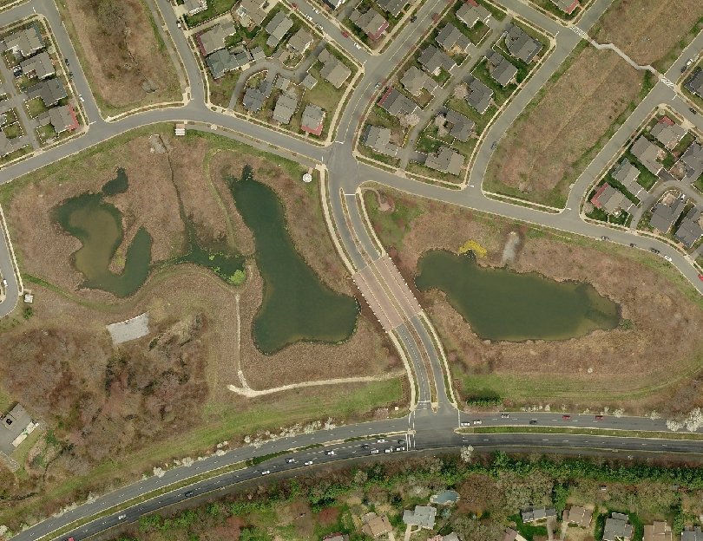
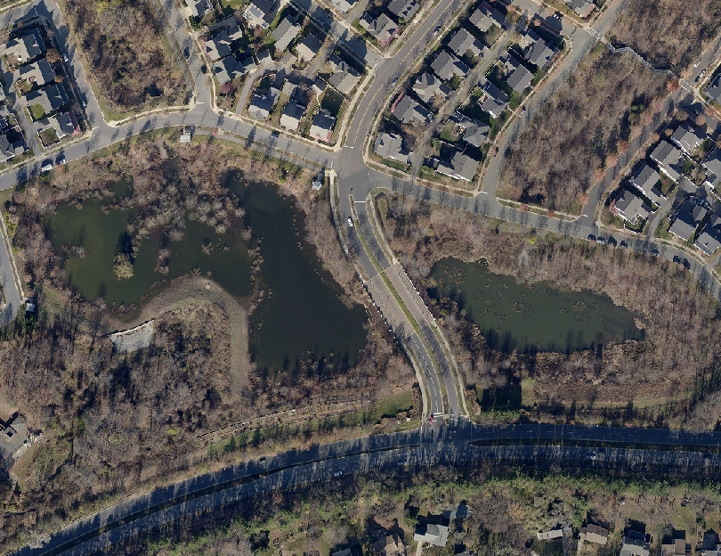
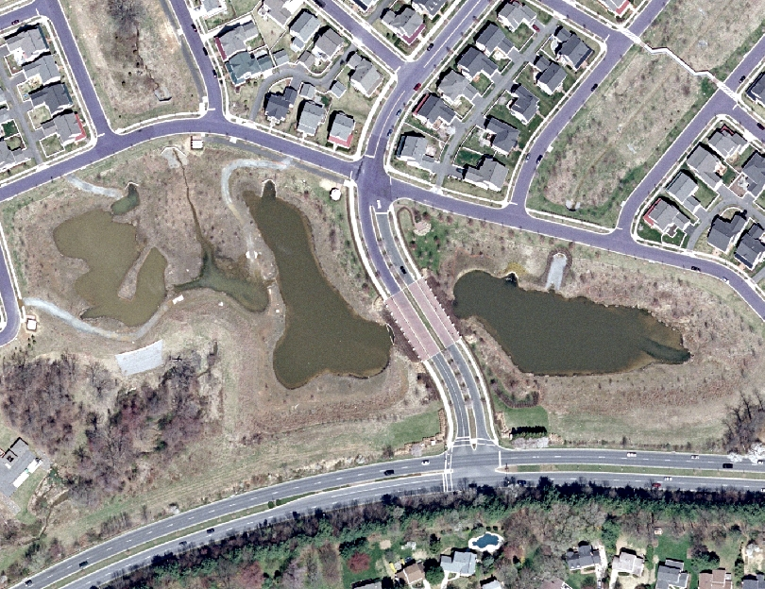
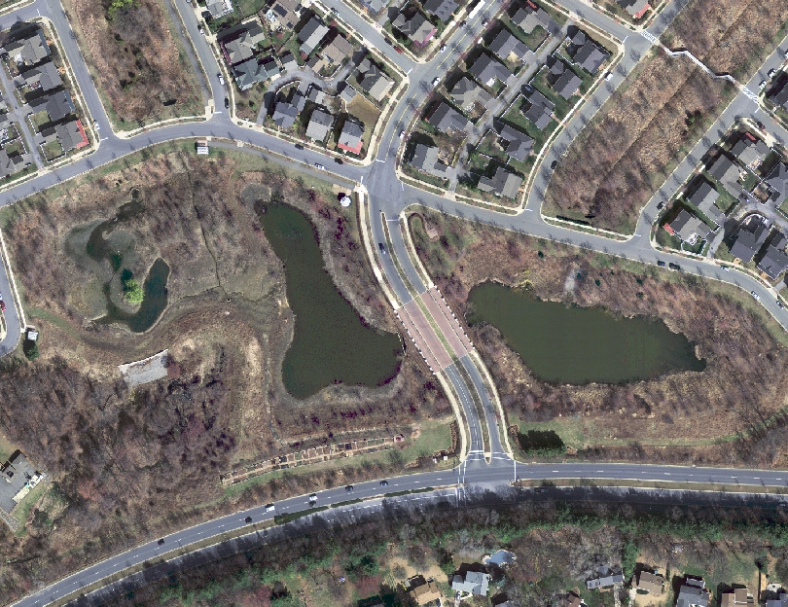
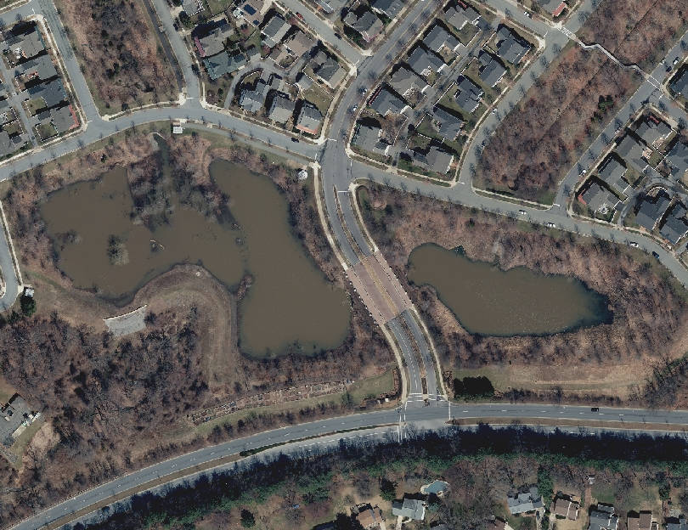
Watkins Pond Sediment Retention - 2008
Watkins Pond Sediment Retention - 2011
Watkins Pond Sediment Retention - 2004
Watkins Pond Sediment Retention - 2012
Watkins Pond Sediment Retention - 2014

Slide 8
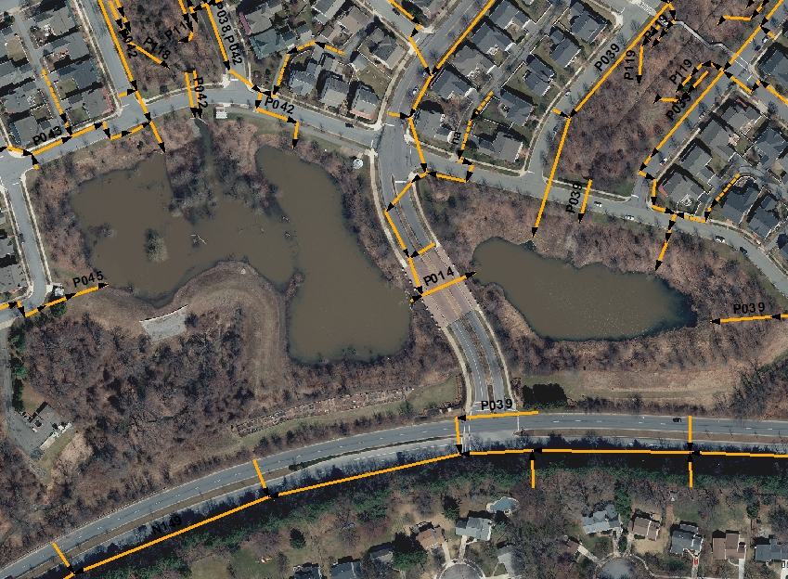
Constructability Issues To Think About
Dredged Sediment removal
Erosion & Sediment Control
Clean water diversions
Access paths
Time of Year and Weather
Notes:
Plan ahead to solve constructability issues. And remember you’ll need to solve these not once, but every time you come back for major maintenance work.
Sediment Removal Is Challenging
Early Estimating of Sediment Dredge Volumes - hard to determine depth of accumulated sediments in wet pond areas without expensive bathymetric surveys (2 guys in a rowboat with a surveying rod probing for the bottom). It’s hard to judge before draining pond how much sediment must be dredged;
pond drain openings may be blocked with sediment accumulation – have to pump down the pond full of water just to start work
Typically little room to store & dewater wet dredge material before hauling offsite – expensive to load and move mud soup. Truck load of dry material is 8-10 CY, but wet material can only load about 4-6 CY per truck.
ESC Issues
ESC control of Maryland state-mandated 2-year design flows is very difficult in ponds with large drainage areas (roughly 40 acres & up), especially in online ponds. May only be able to manage 1-year storms, if that.
MDE ESC specs for dewatering & filtering aren’t provided for more than 10-acre drainage areas, except for sediment basins and those only go up to 100 acres. Need to do engineering designs to adapt standard details.
ESC also includes the sequence of construction, and phasing the work. Use these to break project into more manageable chunks or provide extra space outside the work area.
Consider other ESC measures, if they help meet the intent of diverting clean water and filtering dirty water. One of our Rockville engineers is looking at a skimmer device to help dewater this pond during construction. MDE says we can try this but need to evaluate the design details for appropriate filtering and sediment settling capacity.
Clean Water Diversions
Diverting clean water around your construction in the pond basin will help keep costs down and speed up construction.
Temporarily re-route storm drain inflow points around entire pond
Pipe streams and storm drains directly into the pond outfall
Clean water diversions to route upstream runoff around your pond is harder after surrounding area is developed. Existing storm drain outfalls are now fixed both in location and in depth, which reduces flexibility to divert these. Outfall elevations and pipe sizes are also fixed. Many permanent pond outfalls only allow a bypass flow from the contributing drainage area after the whole basin is under water, which doesn’t work when you’re trying to dredge a drained pond.
For sprawling ponds, consider phased ESC – you can use one side to convey clean water while damming off and working on the other side, at least up to a certain sized storm elevation.
Access Paths
Reinforced access paths are good for light vehicles, but not heavy construction equipment (we had to cover with mulch/timber mats);
Previous access paths may not remain open (if we allowed street trees or reforestation to be planted in or too close to access paths, paths ran through wetlands that have gone back to natural semi-submerged conditions)
establish access path to dam/riser and each storm drain inflow structure for clean-out – it may not be reinforced, but should be reasonably graded, kept clear, and be on public property;
slopes to reach all SD inflow points were sometimes too steep for reasonable truck access (4:1 h:v, is steepest allowed – have to cut path on diagonal).
Time of Year and Wet Weather Affect Costs & Schedule
Wet weather causes extensive delays/extra costs due to repeat filling of basin during construction. Results in days lost while contractor dewaters pond. Pump-downs get particularly expensive; City has successfully used a siphon method to get ponds with 15’ of backed-up water drained. You hook up a couple of pumps to flexible plastic piping that runs from the deepest part of the pond up over the weir wall or riser overflow and back down to the pond barrel elevation. Turn on the pumps, get the pipes full of water, then turn off the pumps. The pipes will suck water down to the discharge elevation, saving the pump fuel costs and contractor oversight. Still takes a day or two, but is much cheaper.
Working in the winter/spring often means more rain and longer times to dry out site, which slows work.
State stream closure periods for fish spawning protection dictate when online projects could be done. Any work for online ponds (i.e., with a stream entering the pond) is subject to MDE’s stream closure period from March 1-June 15, so work has to be completed outside this or you must get a state waiver.
For protecting amphibian/reptile habitat, target construction for late summer/fall/early winter to avoid mating and hibernation seasons.
Watkins Pond example:
Complicated online pond (300-acre drainage area, 3 separate cells, 2 stream inflows, 6 storm drain inflows); clean-water diversions through existing pond basin are much harder to arrange than they were during original construction before all grades, storm drain pipes, pond dam, barrel, etc. were put in place; very deep storm drain pipes just upstream of pond make diversions almost impossible outside of actual pond basin; control structure system included pond drains from two cells to main riser, but did not include a useful large barrel to drain more than the 1-year storm. Large storms must fill pond and overflow a weir wall, which doesn’t have a release valve at its base.

Slide 9
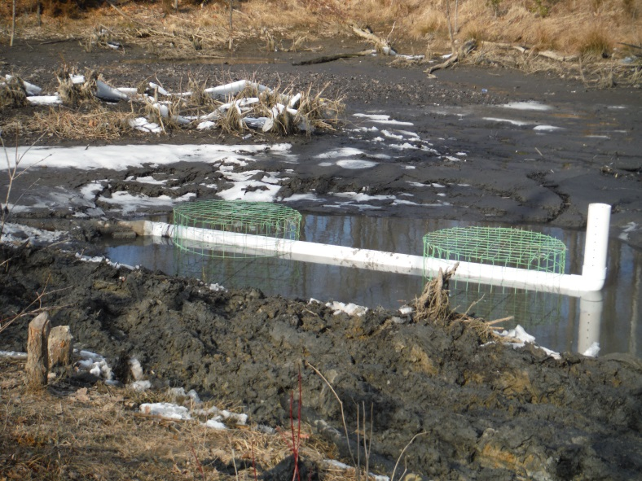
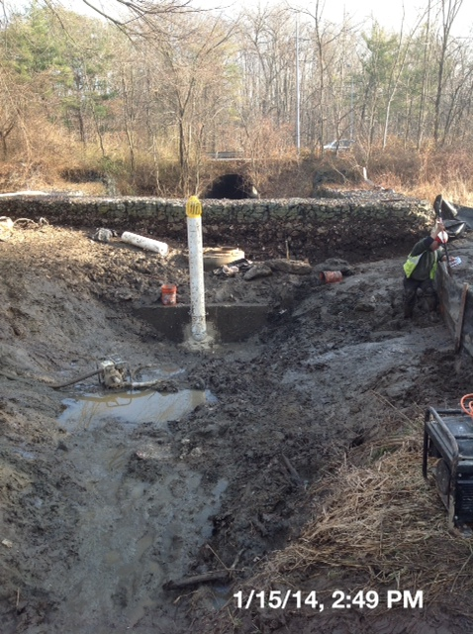
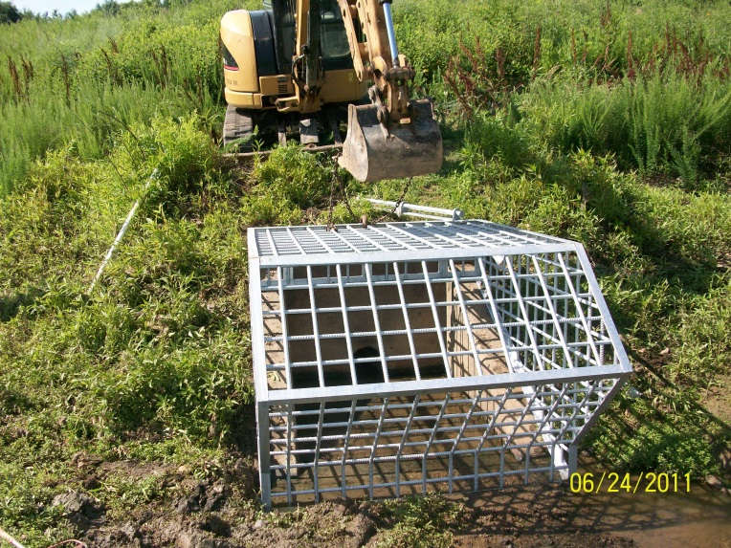
Improving On Original Designs
Notes:
These also apply to new SWM ponds, not just your retrofits!
Outlet Structure Issues
micropools at riser are often so small, they completely silt in; then the pond’s low-flow opening (and pond drain pipe) will be buried under a couple of feet of dirt, leading to blockage.
some ponds have no pond drains, such as older retrofits of previous dry ponds where new pond bottom is lower than pond barrel. This is expensive to work on – it costs to dewater the pond at beginning, and to pump down again each time it rains and fills up. Try the siphon trick, but also try to make the pond less susceptible to clogging.
Older pond designs with CMP risers eventually need replacement with RCP risers – lets us adjust hydraulics and redesign storm control;
Some ponds are just going to be problem children. Even with tweaking, some ponds will always have fairly high maintenance costs because they’re undersized for drainage area (older retrofits), or online in wooded stream valleys.
Clogging Ponds? You’ll need more redundancy in trash rack/low flow openings to prevent clogging.
Add a slotted dewatering standpipe to an outlet structure that keeps silting in. Aim for 2-3 times as much square inches in the openings of the slots or holes in your pipe as you have in the outlet pipe’s cross-sectional area.
Beavers love SWM ponds. Try a beaver deceiver to keep your native beaver population from costing you repeat visits to unblock the outlet pipes
Add a robust trash rack over a low-flow pipe that keeps clogging

Slide 10
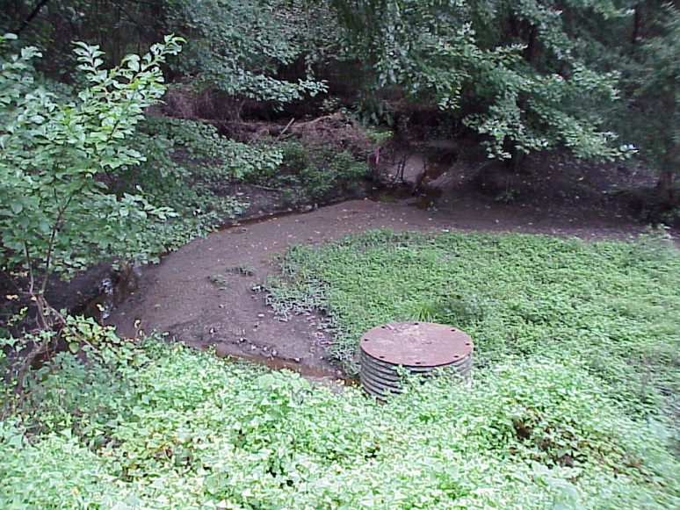
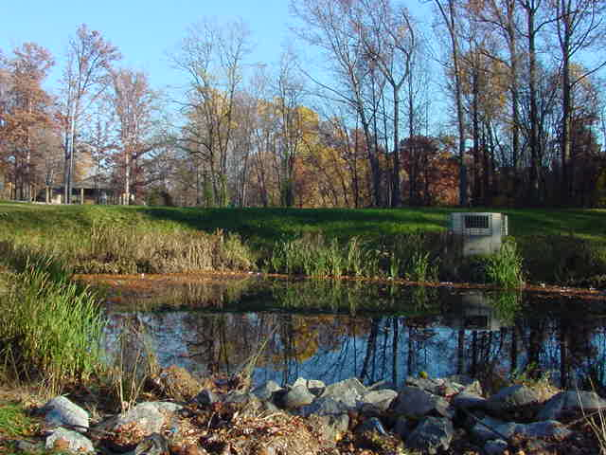
From Dry Pond To Wet Pond
DRY POND
Frequently clogged
CMP riser & barrel rusting out
No water quality treatment
Eyesore
WET POND
New concrete riser and slip-lined barrel
Forebays at inflow points and underwater low-flow outlet
Provides ½” water quality treatment for 51 acres

Slide 11
Lessons Learned
Effective record keeping is essential! Mark up or replace as-built plans.
Iterative process – modify maintenance plan as more data becomes available
Optimize SWM facility design ease and efficiency maintenance activities – build deeper basins, add forebays, keep access paths open
Doing nothing will still cost you!
Notes:
Have contractor provide a redlined as-built to original plans showing any changes for grade, new or modified structures, endwalls, trash racks, pipe extensions, even riprap. Get these into your as-built database (both print or mylar plans and any scanned plan database) so everyone’s using the latest plans.
If original plans are impossible to read, when you retrofit the facility, pay for a decent set of new as-built plans to be provided. Don’t just redline the illegible plans.
Don’t be afraid to fine-tune and retrofit facilities to modify or eliminate things that don’t work. Over time, you’ll save in ongoing maintenance costs, and avoid emergency fixes, poor public perception of failing facilities, and years of ineffective water quality treatment.
Ignore failed SWM facilities at your own risk. It’s costly when you finally have to clean it out, repair it or fix the damage from failure. If a pond has no viable retrofit design now, keep it safe and unclogged and sit on it until a new design idea comes along that helps your program.

