Slide 1
CWEA Welcomes You!

Slide 5
Please enjoy the presentation!
For more information on:
Becoming a CWEA member
Sponsorship opportunities
Future webinars
CWEA Committees and Events
Contact: Traci Storm, CWEA Executive Administrator, at traci@chesapeakewea.org

Slide 6
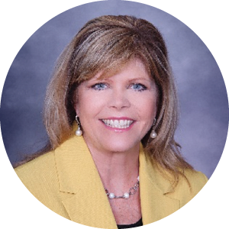
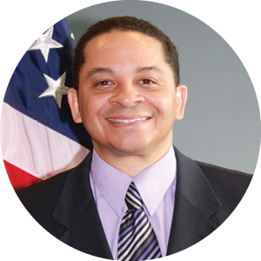
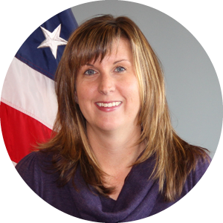
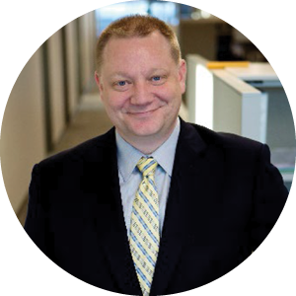
Moderator:
Sharon Kebil-Whisler
Vice President
M&T Bank
Webinar Panelists
Solomon Wheeler
Harrisburg Branch Manager
US Small Business Administration’s
Easter Pennsylvania Office
Kim Stout
Economic Development & Lender Relations Specialist
US Small Business Administration
Steve Snyder
Director – AEC Group
Stambaugh Ness
Jess Seburn
Business Banking Regional Manager
M&T Bank

Slide 7
Contact Information
Moderator – Sharon Kebil-Whisler
Vice-President – Sr. Relationship Banker – M&T Bank
skebil@mtb.com
717.630.4588
Presenter – Solomon Wheeler
Branch Manager/SBDC Project Officer – U.S. Small Business Administration
Solomon.wheeler@sba.gov
717.782.3840
Presenter – Kimberly Stout
Economic Development Specialist – U.S. Small Business Administration
Kimberly.stout@sba.gov
610.382.3080
Presenter – Jess Seburn
Administrative Vice-President – Regional Manager - M&T Bank
jseburn@mtb.com
717.255.2068
Presenter – Steve Snyder, CPA, CCIFP
Director, AEC Group - Stambaugh Ness
ssnyder@stambaughness.com
717.757.6999 ext. 3099
Administrator – Traci Storm
Executive Administrator – CWEA
traci@chesapeakewea.org
410.960.5514

